Slide 1


North Carolina Evictions
By Jasmine Young

Slide 2

Introduction
What is an eviction?
Eviction Filing vs. Eviction
Why do evictions happen?
Underlying Problems

Slide 3

Analysis Questions
Does the racial makeup of a county influence the eviction rate?
Does the proportion of renters influence the eviction rate?
Do property values influence the number of filings or eviction rate? Do other economic measures of income/poverty effect the eviction rate?
Do these trends vary by year (2000 – 2016)?

Slide 4
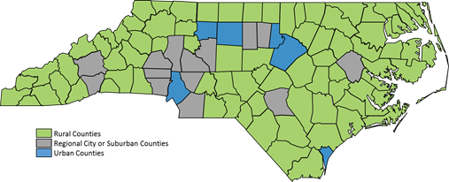
DATA
The Eviction Lab – Princeton University
100 North Carolina Counties
2000 - 2016
Population, Poverty Rate, % Renter Occupied, Median Rent, Median Household Income, Median Property Value, Percent Race

Slide 5
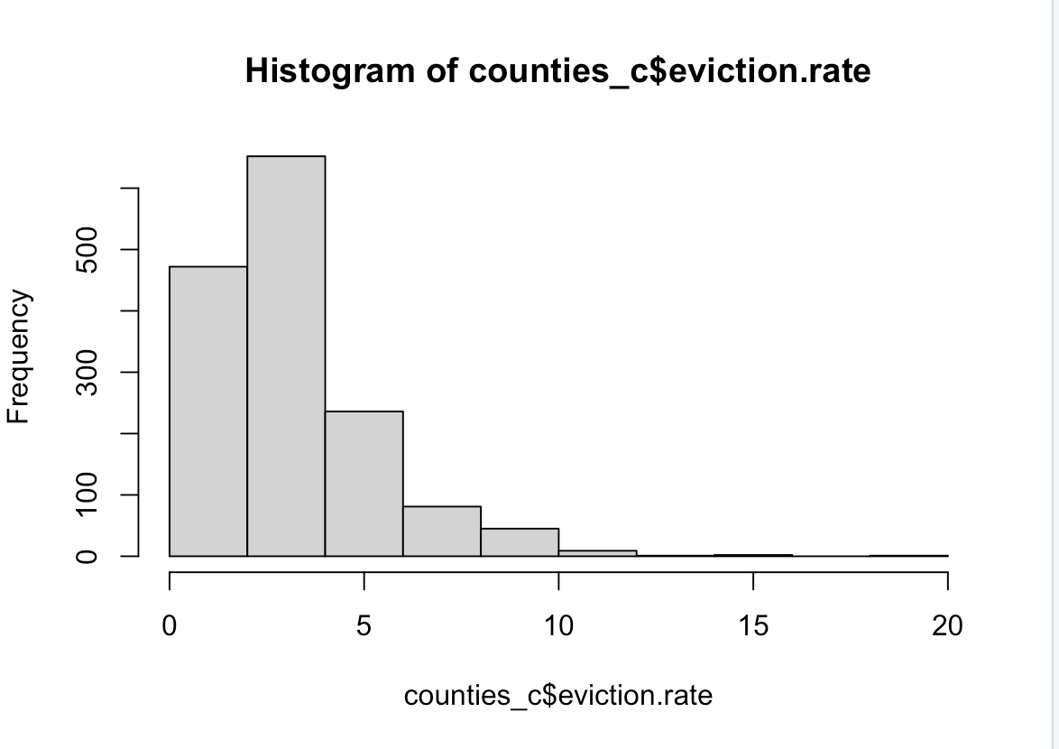
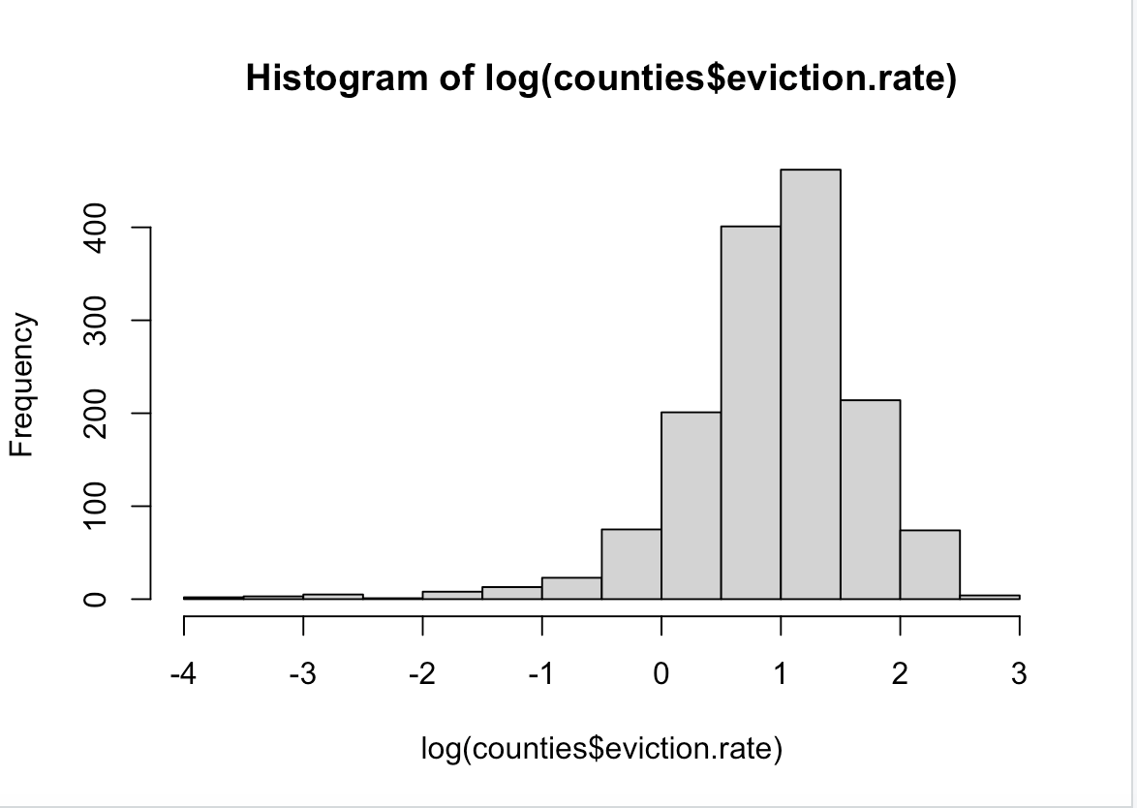
Transformations
Log(Eviction Rate)
Population
Median household Income
Median Property Value

Slide 6

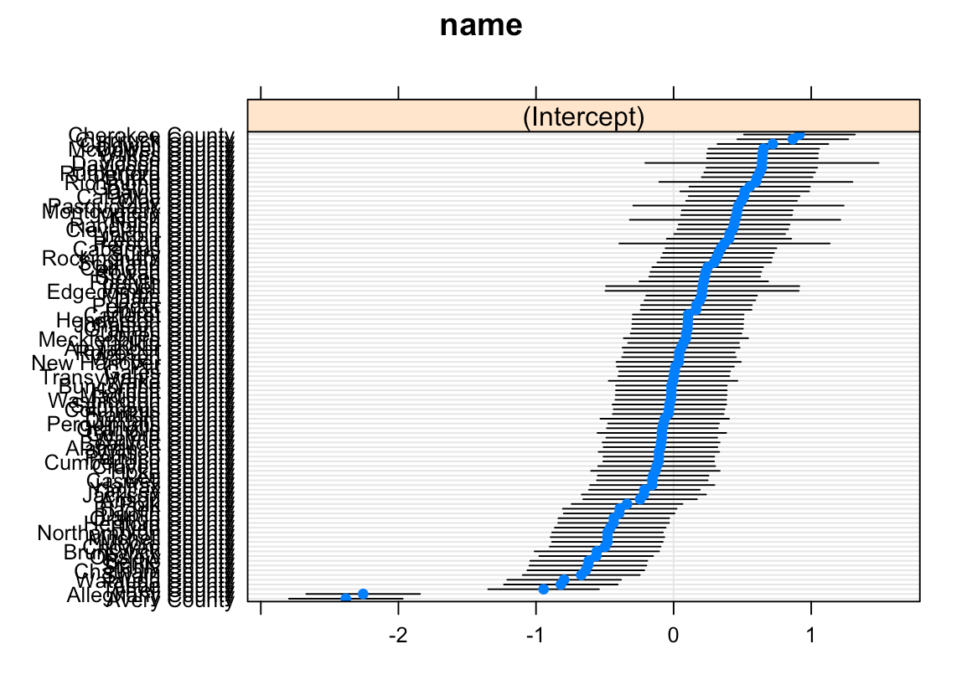
Models
Linear Model
Hierarchical Model
Includes Year as a Predictor
% Asian - 10% decrease
MHI > $50,000 – 88% increase
Year 2008 – 46% decrease
Individual Intercepts for County
Race no longer significant
MHI (35k – 50k) – 23% increase
All years significant

Slide 7
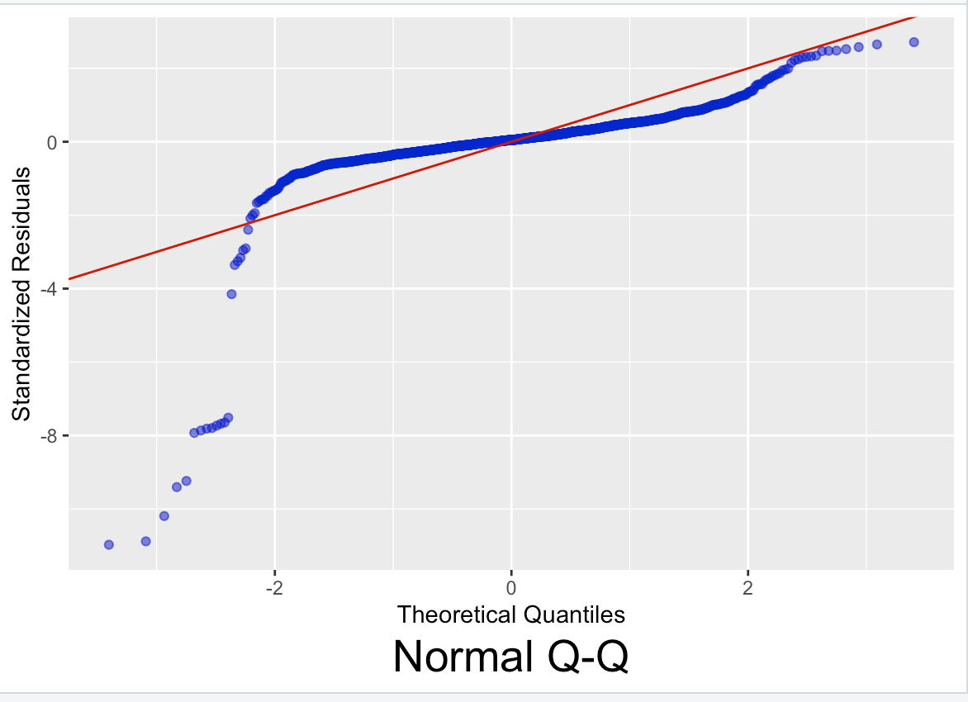

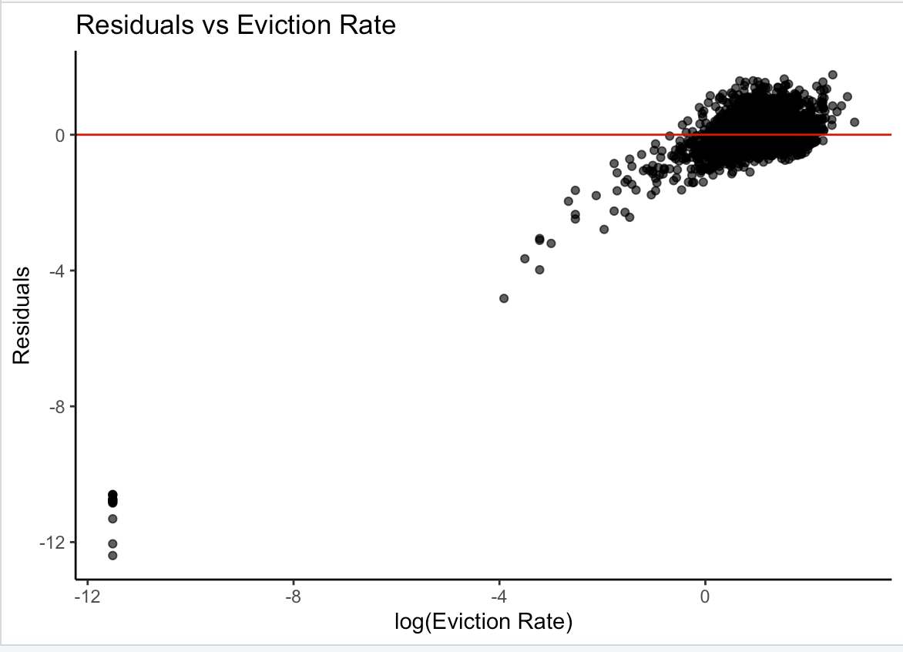

Model Assumptions
Linear Model
Hierarchical Model

Slide 8

Thank you !

